Slide 1
Orbit Propagation to Determine Satellite’s Demise
Jacob Bailey
Gus Lee
Michael Lesnewski

Slide 2

Introduction
Background:
The Chinese space station Tiangong 1 re-entered the Earth’s atmosphere and fell to its demise on April 2, 2018 over the South Pacific Ocean at 24.5°S 151.1°W.
Project Objective:
Propagate the orbit of the Tiangong 1 space station and estimate the lifetime of the space station using both numerical integration of the perturbed Keplerian equations of motion and the averaged Gauss’ variational equations.
Source: https://news.sky.com/story/chinese-space-lab-tiangong-1-re-enters-earths-atmosphere-11313548

Slide 3
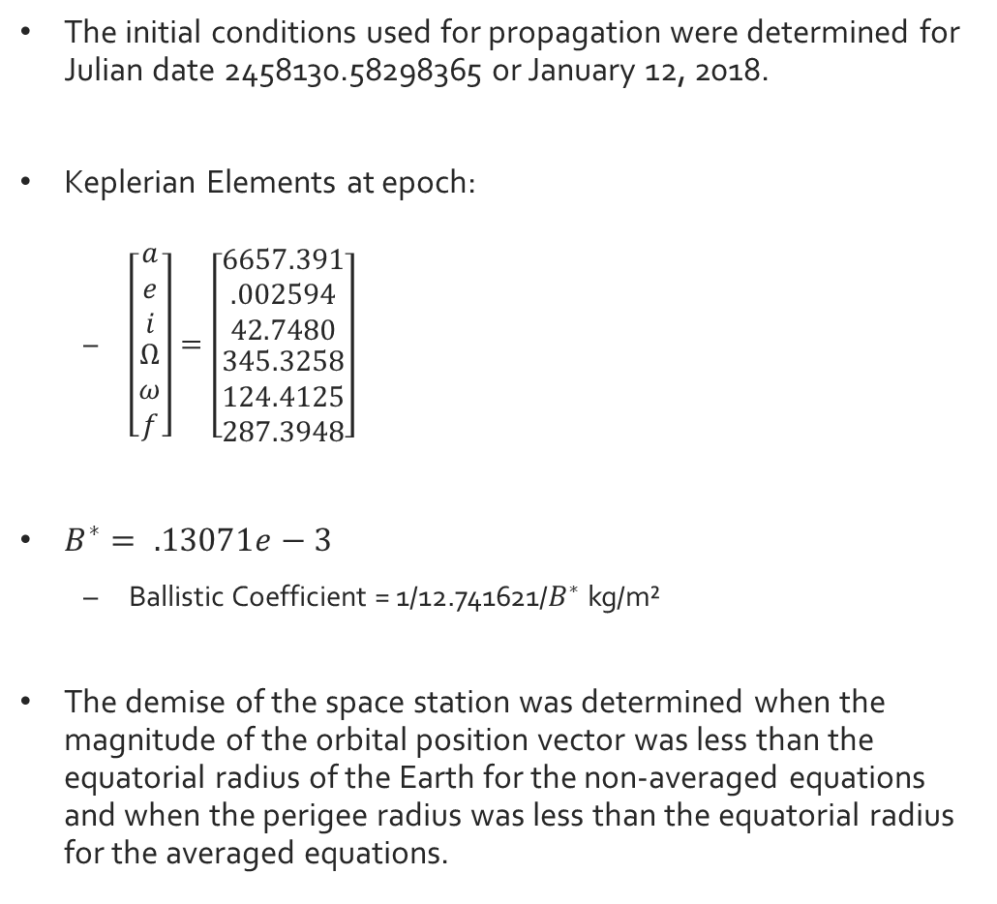
Initial Conditions for Orbit Propagation
The initial conditions used for propagation were determined for Julian date 2458130.58298365 or January 12, 2018.
Keplerian Elements at epoch:
$\left[\begin{matrix}\begin{matrix}a \\ e \\ i\end{matrix} \\ \begin{matrix}Ω \\ ω \\ f\end{matrix}\end{matrix}\right]=\left[\begin{matrix}\begin{matrix}6657.391 \\ .002594 \\ 42.7480\end{matrix} \\ \begin{matrix}345.3258 \\ 124.4125 \\ 287.3948\end{matrix}\end{matrix}\right]$
$B^{∗}= .13071e−3$
Ballistic Coefficient = 1/12.741621/$B^{∗}$ kg/m²
The demise of the space station was determined when the magnitude of the orbital position vector was less than the equatorial radius of the Earth for the non-averaged equations and when the perigee radius was less than the equatorial radius for the averaged equations.

Slide 4
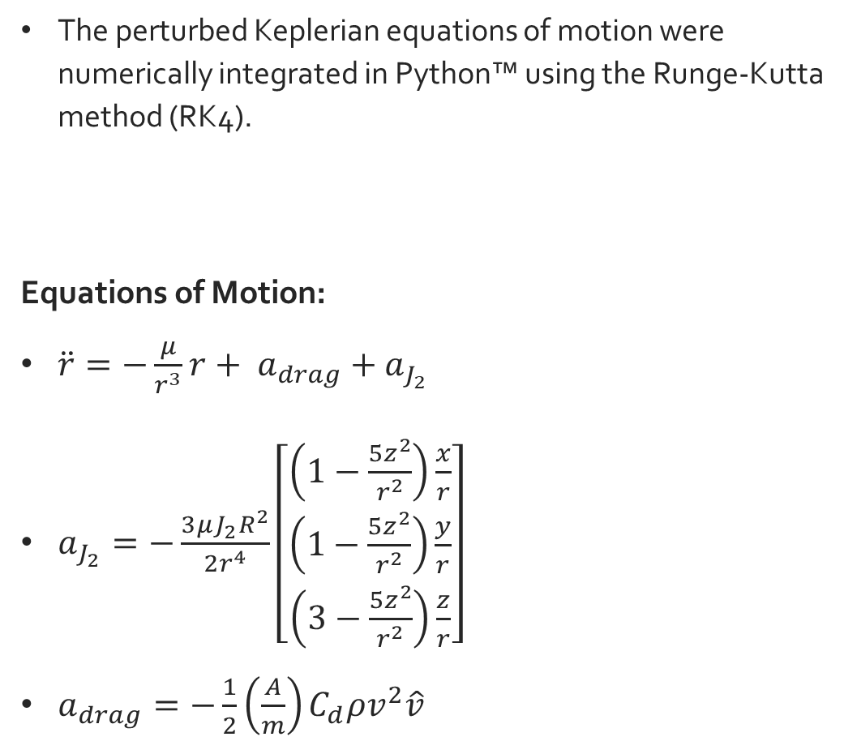
Orbit Propagation using Keplerian Equations of Motion
The perturbed Keplerian equations of motion were numerically integrated in Python™ using the Runge-Kutta method (RK4).
Equations of Motion:
$\ddot{r}=−\frac{μ}{r^{3}}r+ a_{drag}+a_{J_{2}}$
$a_{J_{2}}=−\frac{3μJ_{2}R^{2}}{2r^{4}}\left[\begin{matrix}\left(1−\frac{5z^{2}}{r^{2}}\right)\frac{x}{r} \\ \left(1−\frac{5z^{2}}{r^{2}}\right)\frac{y}{r} \\ \left(3−\frac{5z^{2}}{r^{2}}\right)\frac{z}{r}\end{matrix}\right]$
$a_{drag}=−\frac{1}{2}\left(\frac{A}{m}\right)C_{d}ρv^{2}\hat{v}$

Slide 5
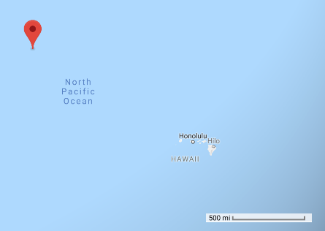
Results: Numerical Integration of Keplerian Equations
Time of a demise: 153 days after the observation epoch or June 14, 2018.
73 day difference from actual re-entry date.
This puts the calculated crash site to be in the North Pacific, about 100 miles northwest of Hawaii.
Final Position (m) | Final Velocity (m/s)
-3762391.12 | 59.76
3577671.24 | -57.18
3704724.90 | -59.06
Calculated Crash Site Location
Latitude | Longitude | Altitude (km)
35.617 | -176.056 | 7186.99

Slide 6
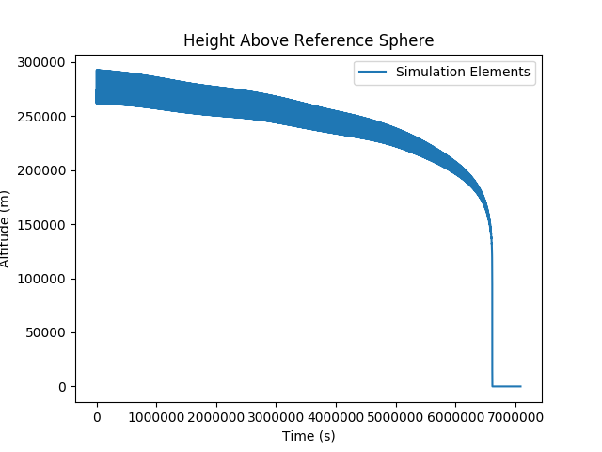
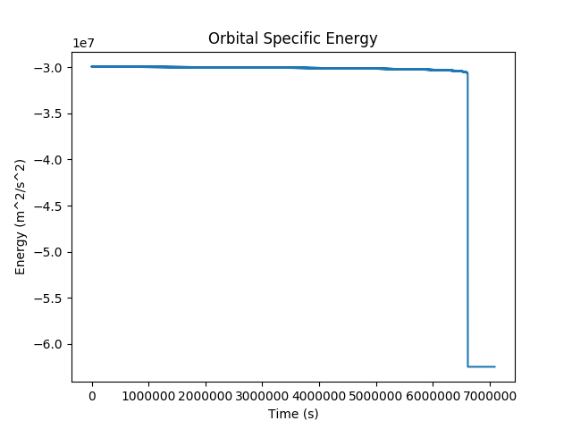
Plots: Numerical Integration
Altitude and Specific Energy decay as expected due to the presence of drag

Slide 7
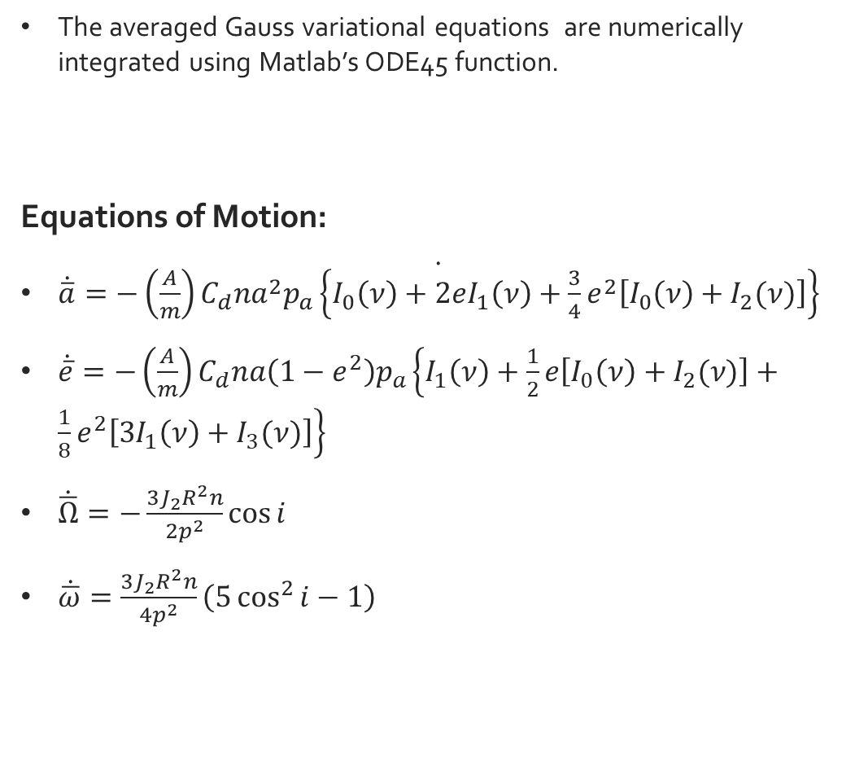
Orbit Propagation using Gauss’ Variational Equations
The averaged Gauss variational equations are numerically integrated using Matlab’s ODE45 function.
Equations of Motion:
$\dot{\dot{\overline{a}}=−\left(\frac{A}{m}\right)C_{d}na^{2}p_{a}\left\{I_{0}\left(ν\right)+2eI_{1}\left(ν\right)+\frac{3}{4}e^{2}\left[I_{0}\left(ν\right)+I_{2}(ν)\right]\right\}}$
$\dot{\overline{e}}=−\left(\frac{A}{m}\right)C_{d}na\left(1−e^{2}\right)p_{a}\left\{I_{1}\left(ν\right)+\frac{1}{2}e\left[I_{0}\left(ν\right)+I_{2}(ν)\right]+\frac{1}{8}e^{2}\left[3I_{1}\left(ν\right)+I_{3}(ν)\right]\right\}$
$\dot{\overline{Ω}}=−\frac{3J_{2}R^{2}n}{2p^{2}}\cos{i}$
$\dot{\overline{ω}}=\frac{3J_{2}R^{2}n}{4p^{2}}\left(5\cos^{2}{i}−1\right)$

Slide 8
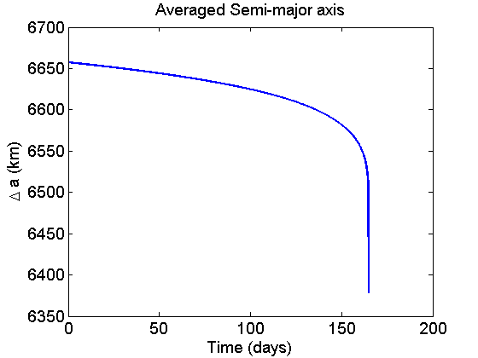
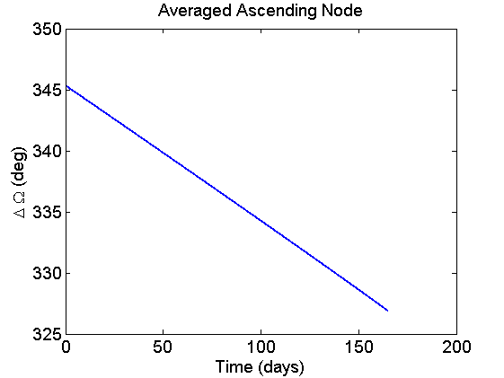
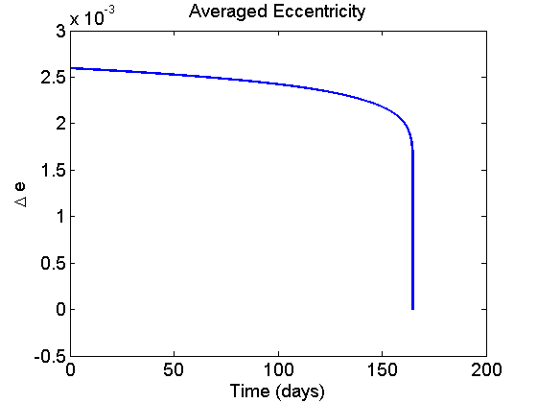
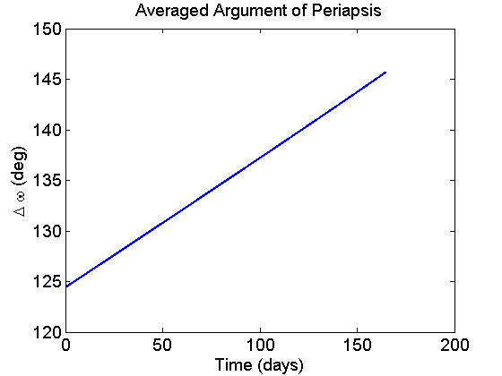
Results: Gauss Variational Equations
Time of a demise: 165 days after the observation epoch or June 27, 2018.
86 day difference from actual re-entry date.

Slide 9
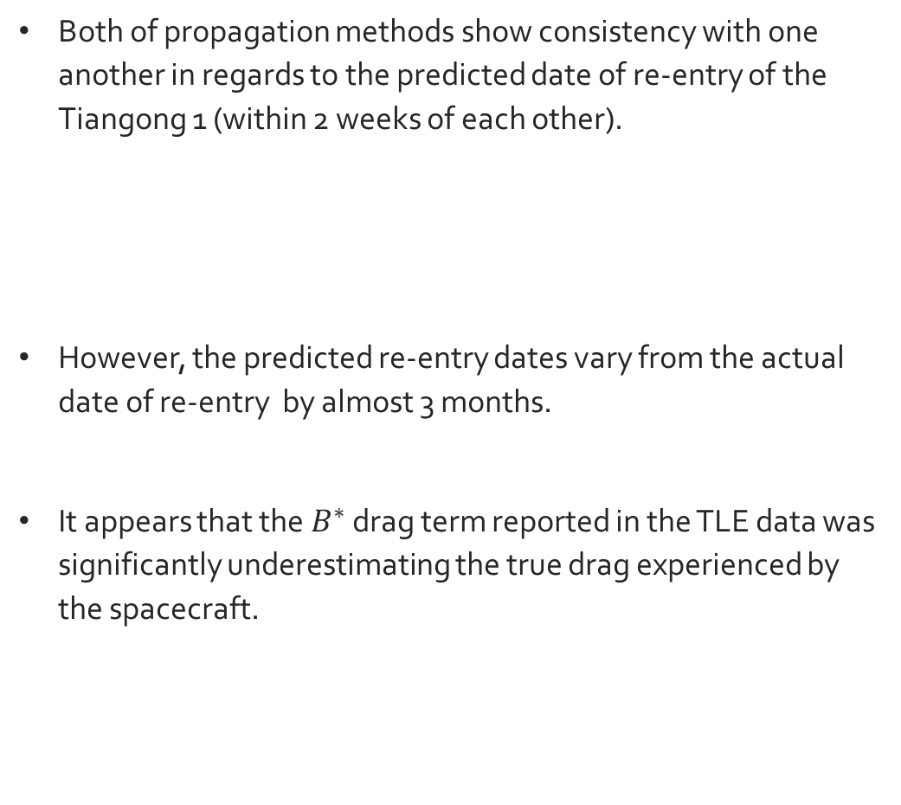
Project Conclusions
Both of propagation methods show consistency with one another in regards to the predicted date of re-entry of the Tiangong 1 (within 2 weeks of each other).
However, the predicted re-entry dates vary from the actual date of re-entry by almost 3 months.
It appears that the $B^{∗}$ drag term reported in the TLE data was significantly underestimating the true drag experienced by the spacecraft.
Propagation Method | Date of Re-entry
Perturbed Keplerian Eqs. | June 14, 2018
Gauss’ Variational Eqs. | June 27, 2018

